Slide 1



me.io
home
about
Please login with FaceBook to continue…
Login
Sign up
Notes:
Normal home screen for users who have already logged in

Slide 2
me.io
home
about
Notes:
About UI

Slide 3
me.io
home
about
Follow instructions above to get your data file then drag it
onto this screen to upload it.
Notes:
Normal home screen for users who have already logged in

Slide 4
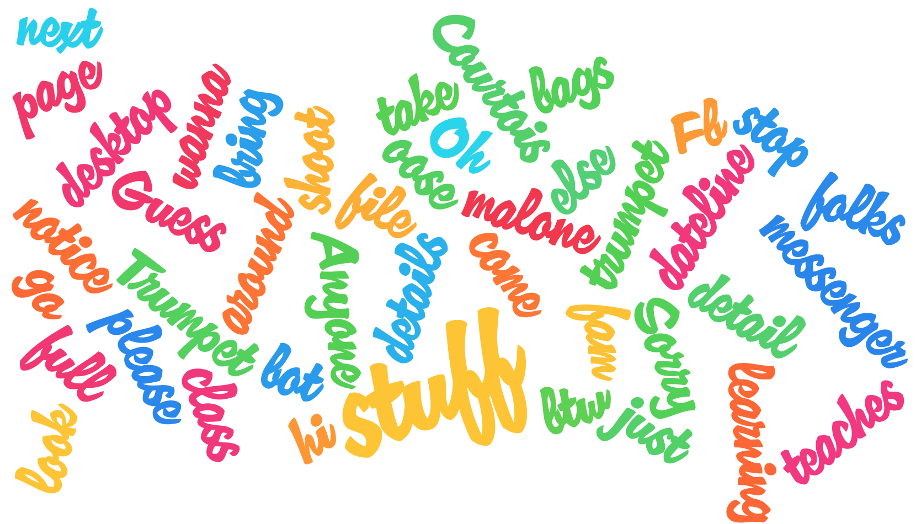


Daily Message Histogram
me.io
home
settings
meBot
about
Response Time
Sentiment analysis
Emily B
Manyu S
Tanay A
Nirmal K
Jon L
Notes:
Normal home screen for users who have already logged in

Slide 5
Daily Message Histogram
me.io
home
settings
meBot
about
Choose parameters:
Time frame:
1 Month
User:
John Smith (self)
Notes:
Normal home screen for users who have already logged in

Slide 6
me.io
home
settings
meBot
about
Account
General
Data
Terms of Service
Notes:
Settings screen

Slide 7
me.io
home
settings
meBot
about
Type a message here…|
Notes:
Chat bot UI

Slide 8
me.io
home
settings
meBot
about
Notes:
About UI

